Slide 1
Week at A Glance for Science
January
5-6
Weather and
Climate

Slide 2
S6E4. Obtain, evaluate, and communicate information about how the sun, land, and water affect climate and weather.
Analyze and interpret data to compare and contrast the composition of Earth’s atmospheric layers (including the ozone layer) and greenhouse gases. (Clarification statement: Earth’s atmospheric layers include the troposphere, stratosphere, mesosphere, and thermosphere.)
Plan and carry out an investigation to demonstrate how energy from the sun transfers heat to air, land and water at different rates. (Clarification statement: Heat transfer should include the processes of conduction, convection, and radiation.)
Develop a model demonstrating the interaction between unequal heating and the rotation of the Earth that causes local and global wind systems.
Construct an explanation of the relationship between air pressure, weather fronts, and air masses and meteorological events such as tornados and thunderstorms.
Analyze and interpret weather data to explain the effects of moisture evaporating from the ocean on weather patterns and weather events such as hurricanes.

Slide 3
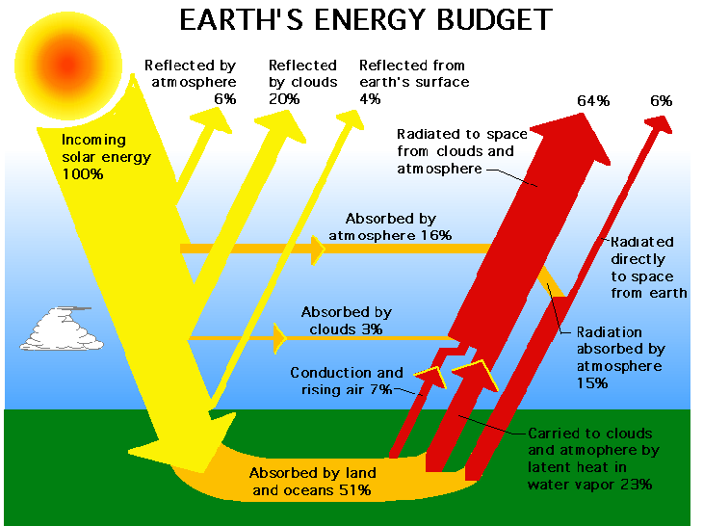
Plan and carry out an investigation to demonstrate how energy from the sun transfers heat to air, land and water at different rates. (Clarification statement: Heat transfer should include the processes of conduction, convection, and radiation.)

Slide 4
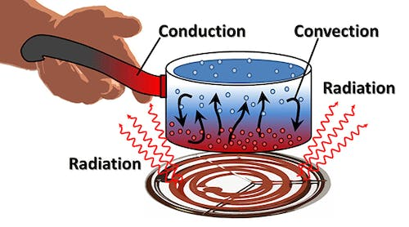

Slide 5
Thursday, January 5
Standard: Plan and carry out an investigation to demonstrate how energy from the sun transfers heat to air, land and water at different rates. (Clarification statement: Heat transfer should include the processes of conduction, convection, and radiation.)
Learning Target: I can explain how energy from the sun transfers heat to air, land, and water
Warm-up: Chapter 13 Workbook Packet
Work Session: Introduce New Unit: 3 Weather and Climate; Conduction, Convection, and Radiation; Video; Introduce Science Fair Project
Closing: Think Pair Share
Reminders:

Slide 6
Friday, January 6
Standard: Plan and carry out an investigation to demonstrate how energy from the sun transfers heat to air, land and water at different rates. (Clarification statement: Heat transfer should include the processes of conduction, convection, and radiation.)
Learning Target: I can explain how energy from the sun transfers heat to air, land, and water
Warm-up: Chapter 13 Workbook Packet
Work Session: Introduce New Unit: 3 Weather and Climate; Conduction, Convection, and Radiation; Video; Introduce Science Fair Project
Closing: Think Pair Share
Reminders:

Slide 7
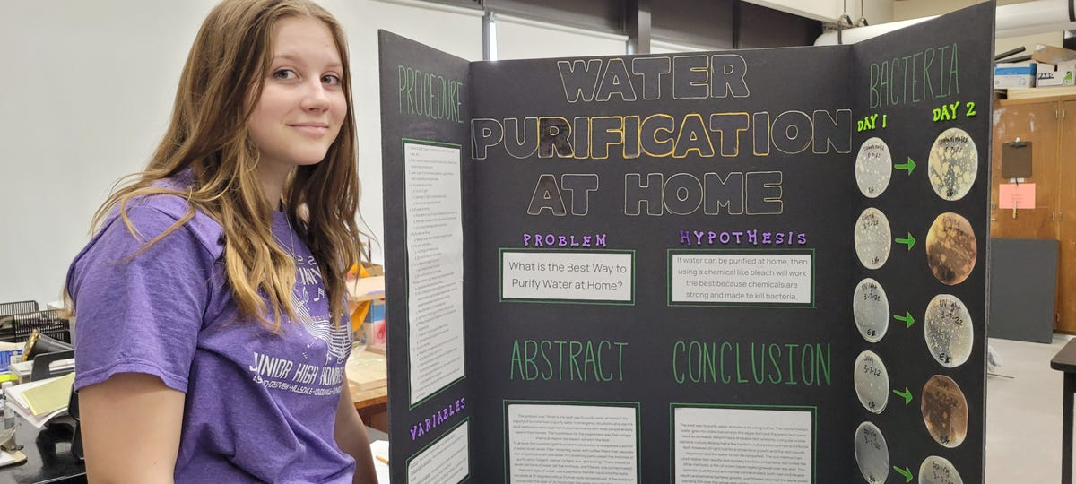
Science Fair Project

Slide 8
Video Link to video

Slide 9
Homework for Science
Monday:
Tuesday:
Wednesday:
Thursday:

